Slide 1
Christian Living Communities
Faith based, not-for-profit organization.
Serving over 950 seniors each day.
CCRC (Residential, Assisted Living & Skilled).

Slide 2
Christian Living Communities
3 Communities:
  Clermont Park, Holly Creek & Someren Glen.
  600 employees
Community Support Services:
  Home Care Services and Staffing Resources.
Adult Day Services.

Slide 3
HR Challenges for CLC
Outdated orientation and training programs.
Employee on-boarding was scattered throughout CLC’s silos.
Inconsistent message about mission, values, standards of service and overall culture of CLC.
Some new hires never even received a “welcome”
Negative feedback from new hires: “eaten alive”
Poor retention of new hires throughout CLC.

Slide 4
Challenges for CLC
Analysis of Nursing New Hires leaving within the first year
  For every 2 C.N.A.’s Hired – we lost 1 = 50% retention
  For every 7 LPN’s Hired – we lost 3 = 42% retention
  For every 7 RN’s Hired – we lost 4 = 57% retention
Main reason for employees leaving us:
  “Easier job” or “Job was harder than I expected”
  “Lack of training/orientation”
Negative financial impact on CLC
Negative impact on residents and quality of care

Slide 5
What the new Team Member
Needs to be successful
Formal Rules
  Skill Competencies.
  8 hours of clinical orientation.
A “best friend at work”
  One on one individualized training.
  Skill competency completion in the clinical setting.
  Mentor is a point of contact for coworkers.

Slide 6
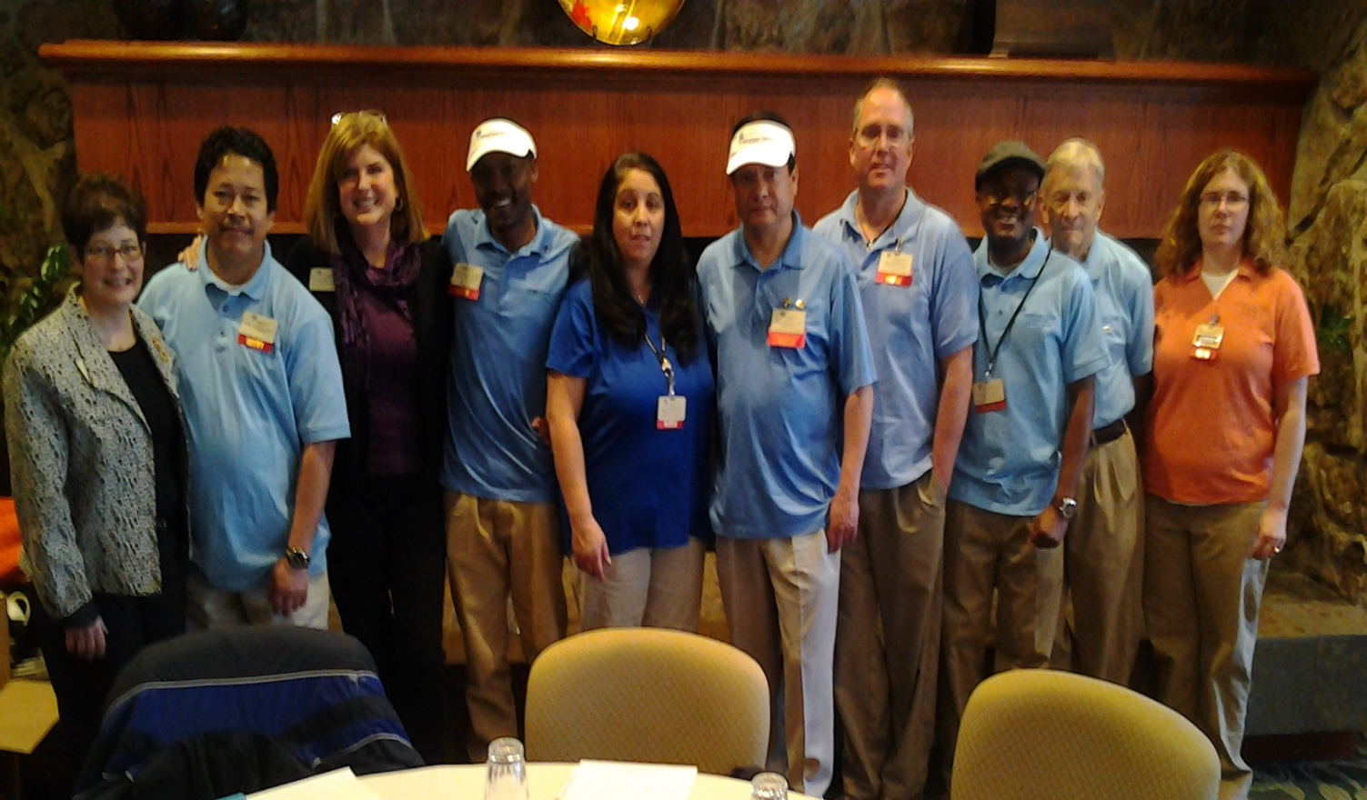
mentors

Slide 7
Mentorship Program
All newly hired Nursing and Certified Nursing Assistants.
Skilled and Assisted Living and Home Care.
One year program.
Day long classroom clinical orientation immediately following general orientation; dovetailed.
Completion of skill competencies through personalized training in the communities.
Year long (plus) structured relationship with specially trained and chosen mentors.
Evaluated throughout the year.

Slide 8
Mentors
Nominated by DONs and peers
Chosen for:
  Outstanding Skills.
  Great communicators.
  Lives the Organization’s mission and values.
To be considered:
  6 months in their current position / no disciplinary action.

Slide 9

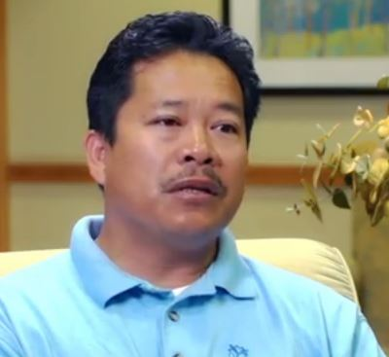

Slide 10
Mentor Training
Training Areas:
  Leadership
  Stress & Time Management
  Mentee needs
  Adult learning concepts
  Team building & Managing Change
  Evaluating work performance with feedback
  Communication
Testing the Skills Competencies
Recognition of new mentors

Slide 12
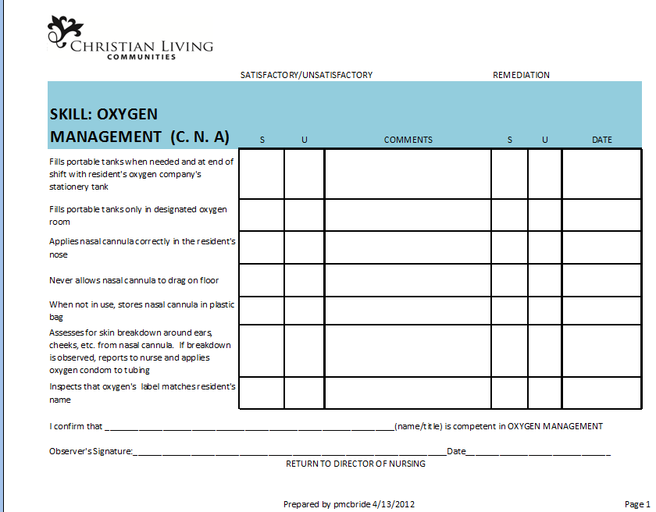

Slide 13
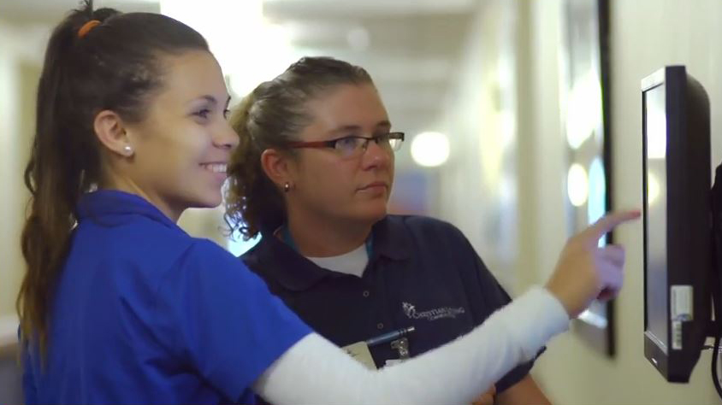
“Best friend at work”

Slide 14
Less nurses “eating their own”

Slide 15
Nursing Department Retention Rates

Slide 16
Improved survey results
  Total 2008 – 2011 = 122 citations with resurvey and complaint citations.
  2012 = 10 citations
  2013= 8 citations
  2014= 5 citations!

Slide 17
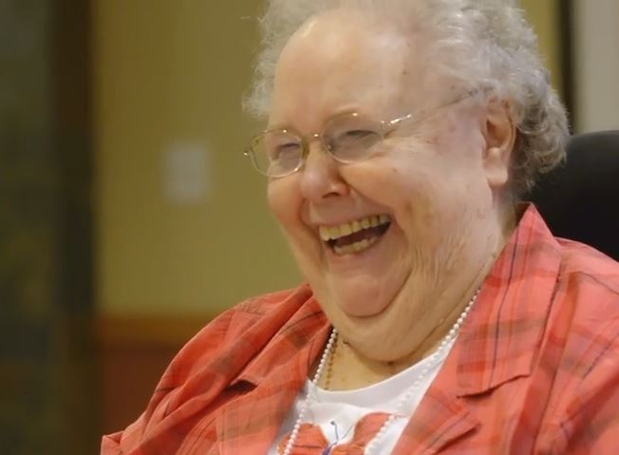
Consistent assignments resident involvement

Slide 18


Ease of Evaluating and Introducing new skills and concepts
Health Activation Begins
with PAM® Assessment.
􀀄􀀆􀀏􀀉􀀈􀀋􀀏􀀁􀀂􀀄􀀆􀀏􀀉􀀈􀀋􀀏􀀁􀀂􀀇􀀏􀀉􀀑􀀆􀀏􀀉􀀌􀀋􀀁􀀃􀀈􀀆􀀎􀀐􀀍􀀈􀀖􀀁􀀔􀀄􀀂􀀃􀀖􀀕􀀁􀀅􀀐􀀍􀀑􀀈􀀒􀀁􀀇􀀏􀀉􀀑􀀆􀀏􀀉􀀌􀀋􀀁􀀃􀀈􀀆􀀎􀀐􀀍􀀈􀀖􀀁􀀔􀀄􀀂􀀃􀀖􀀕􀀁􀀅􀀐􀀍􀀑􀀈􀀒􀀁

Slide 19
Other Benefits of the Mentor Program
More confident, better trained staff.
Significantly less use (if any) of agency.
Total Agency Usage for 2011 = 3,185 hours
Total Agency Usage for 2012 YTD = 174 hours
Total Agency Usage for 2013= 0 hours
Record for progressive discipline if needed.
Development of future leaders.

Slide 20
Other Benefits of Mentor Program
More comfortable recruiting new grads.
Pay for performance application.
Ready made focus groups.
Marketing tool.
Peer educational development

Slide 21
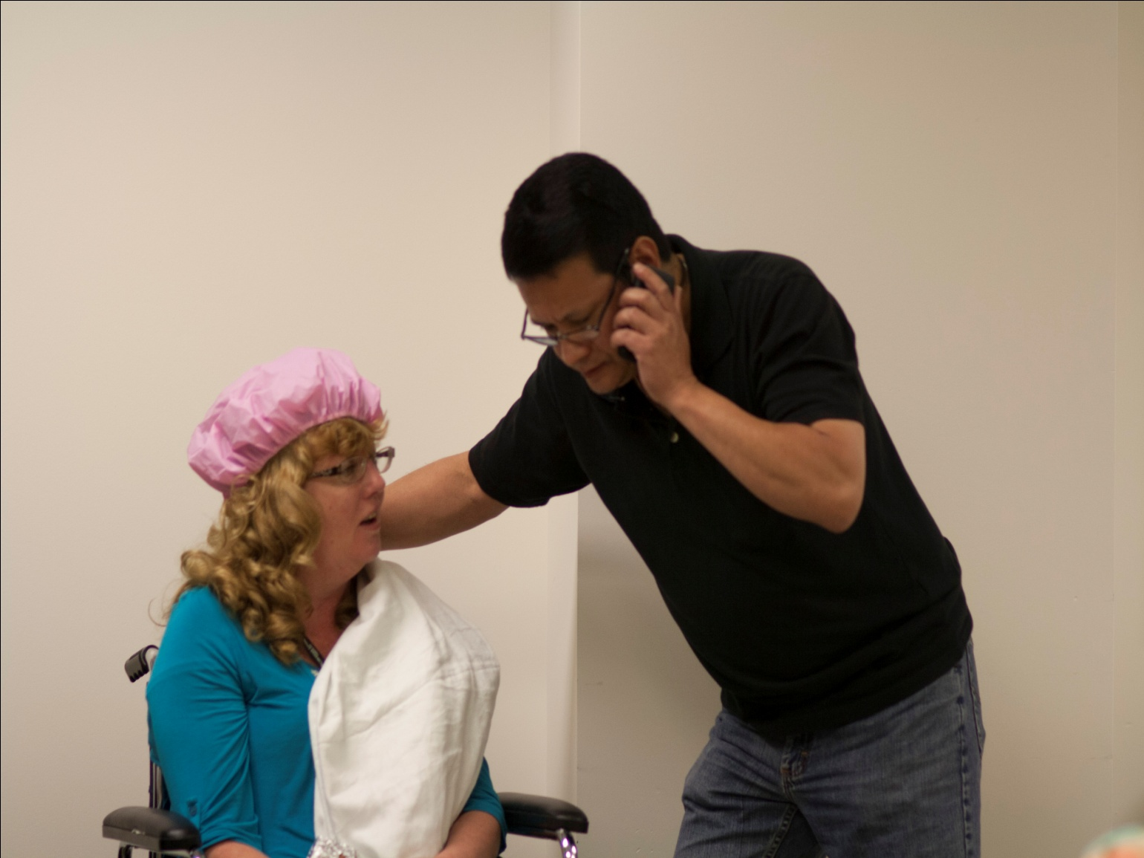
“The Etiquette Experience”

Slide 22
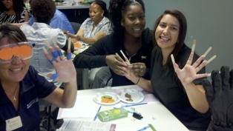
“The Empathy experience”

Slide 23
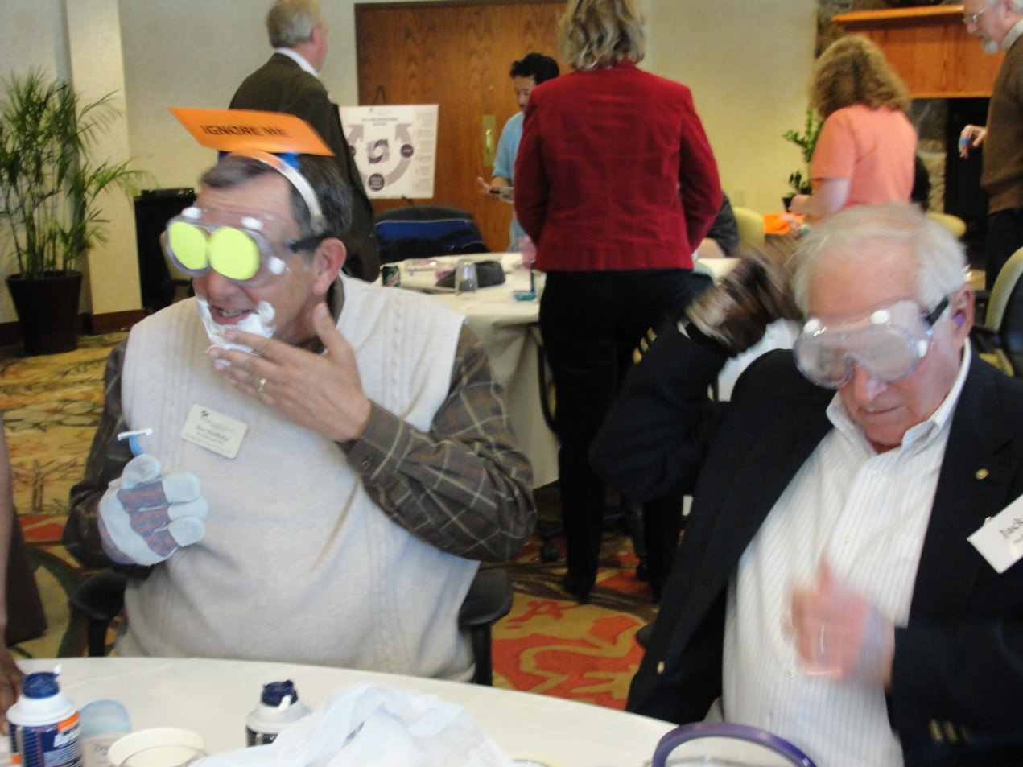
Unlimited possibilities

Slide 24
Mentor Program Video
..\VIDS\Mentor Program-HD 720p Video Sharing.mov

